Slide 1
Event Handlers
IN721 2015
Design and Development for Mobile Devices
Session 1.2

Slide 2
Event Driven Applications
Widgets have events
Bind an instance of a class which implements an appropriate interface.
The handler code is one of the methods of the interface.
Notes:
As usual, widgets have events, which are raised by the system in response to system actions (i.e. onClick) or programmatically (onPause)
You define event handlers and bind them to the events. When the system raises the event, the handler code is executed.
In .NET or JavaScript, we bind a function (or function pointer/delegate).
(You may not realise that you have done this, but you have, every time you wrote a button click handler in C# or Visual C++. )
We tell the system: “When this event happens, call this function.”
In Android it is slightly different.
Here, we bind an instance of a class which implements an appropriate interface.
The handler code is one of the methods of the interface.
Although you will have already met interfaces in Java, that was a while ago, so we will take a quick review.
NB: If you’re taking OOSD, you will be learning a lot more about the uses of interfaces – here we just want to learn as much as we need to know.

Slide 3
Interface
A collection of logically related methods.
No data.
No code.
Not a class definition
Classes can “implement the interface”
They promise to provide code for every method included in the interface definition.
Notes:
A collection of logically related methods. No data. No code. Just a set of behaviours that generally go together.
(In languages that don’t support interfaces, this is equivalent to a pure abstract class.)
So an interface doesn’t say anything about how something is accomplished, it just says that here are some jobs that usually go together.
A class that implements that interface promises to provide methods to do all those jobs.
To understand interfaces, I like to use a sort of real world example:
Each spring, the spouting on my house needs to be cleaned. I can call the plumber or the builder. Each of them has, if you will, a CleanSpouting() method.
They do this job differently (polymorphically). The builder gets a big ladder and climbs it to reach the second floor. He uses a water hose. The plumber puts on a rope and climbs out the upstairs windows. He uses a shovel and a bucket. But I don’t care. As long as the spouting is cleaned, they can do whatever they like.
Someone might propose making a base class “HomeMaintenancePerson” that has various descendent branches and one of them includes all the HomeMaintenancePersons who CleanSpouting.
You might be able to make something sensible here (although it would be tricky), but the problem is more complicated, because sometimes the spouting is actually cleaned by an instance of the Husband class, and there is basically no sensible object hierarchy that connects Husband and HomeMaintenancePerson and lets them both have CleanSpouting without making a big mess (specifically a whole bunch of classes that have the method but don’t need it, and that’s just bad OO).
In this case, the commonality of Plumber and Husband is not what they are it is what they do.
I just want to be able to identify an object as “one of those classes that can clean spouting”. I don’t care about how they do it, or what else they know (fields) or can do (methods).
I might want to define my nice new interface like this...

Slide 4
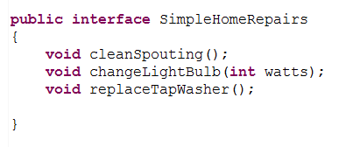
Interface
Notes:
Any class – husband or homeRepairProfessional, or whatever – can state that they wish to implement this interface.
They are then required, for compilation, to provide code for these three methods.
Nobody care how they do it, or what else the do or know, but they have to provide these three methods.
So Plumber instances and Husband instances both must provide methods cleanSpouting(), changeLightBulb(), and replaceTapWasher.
This can be a very powerful tool.
Here’s why...

Slide 5



Interface as Type
An interface can be used syntactically like a type
Notes:
This variable – homeRepairer – can be any class at all, as long as that class implement SimpleHomeRepairs.
So, either of these two instantiations is fine.
And, regardless of what class I assign to the variable, I know that I can make this call.
It’s very powerful and flexible.
Interfaces have other important roles. For example, when used to define function arguments, they allow you to write methods that can accept arguments of different classes. They can also be used to provide an approximation of multiple inheritance in languages like Java, that don’t permit it.
They are pretty wonderful.
For our purposes, concentrate on the fact that
An interface is a set of logically related methods
If you implement an interface, you have to provide code for those methods
Variables can be identified by the kind of interface they implement, rather than the kind of class that they are.
Such a variable will expose all the methods in the interface.

Slide 6
Event Handlers
Widgets have events
Bind an instance of a class which implements an appropriate interface.
The handler code is one of the methods of the interface.
widget.eventSetter(objectThatImplementsInterface)
Notes:
You remember, this is what we were actually talking about?
Here’s what it looks like schematically in the code:
Basically, you have a reference to a control. How will you get it? findViewById.
It will understand a bunch of events, and it will have an event setter method for each one
You will need to pass an object into that setter, which implements an appropriate interface.
So how can we create those objects? => There are a number of syntactic options.
Let’s look at some examples.

Slide 7
Example
Buttons support the onClick event
Bind with setOnClickListener
Requires an object that implements the OnClickListener interface.
The handler method is onClick(View v)
Notes:
So if you look at the definition of the OnClickListener interface, you will see that one of the methods it contains is onClick
Actually, this is the only method it contains.
So assume we have an Activity with a button. How do we attach some code to the button click?
We have some choices....

Slide 8
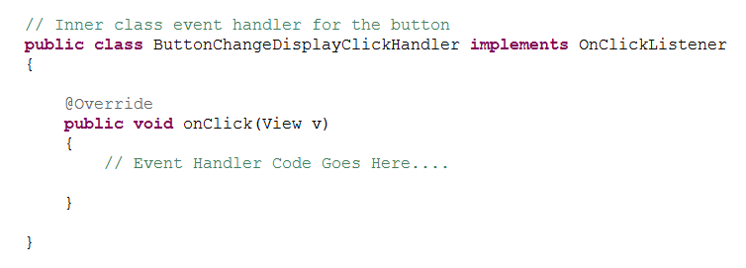
Method 1 – As Inner Class
Define the handler as a separate inner class in the Activity
Notes:
We create a class that implements OnClickListener and, therefore, provides code for onClick(View v)
Like this...
What is the advantage of defining as an inner class? => access to consumer's fields and methods
Here’s some code we might put into the onClick method...

Slide 9
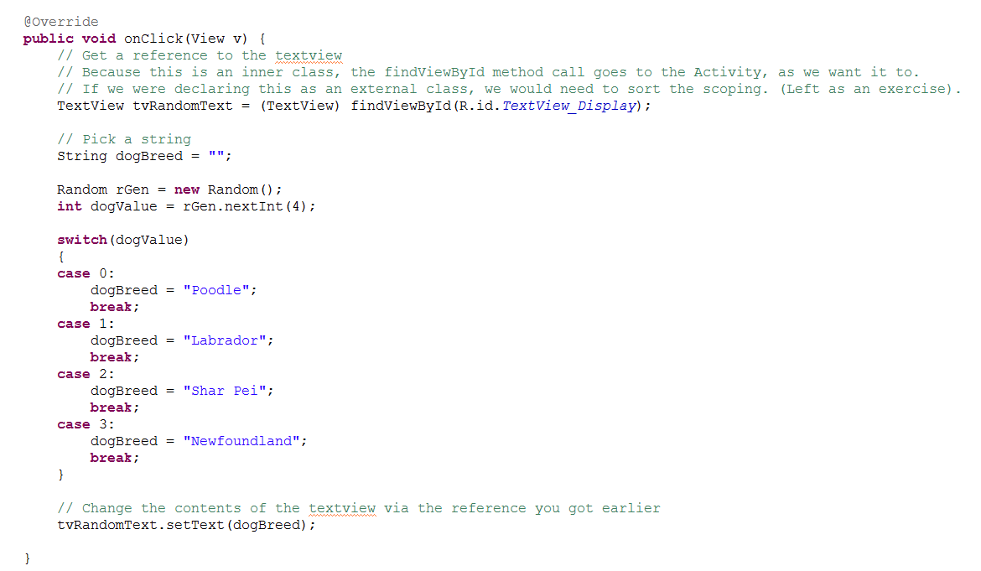
Method 1 – As Inner Class

Slide 10
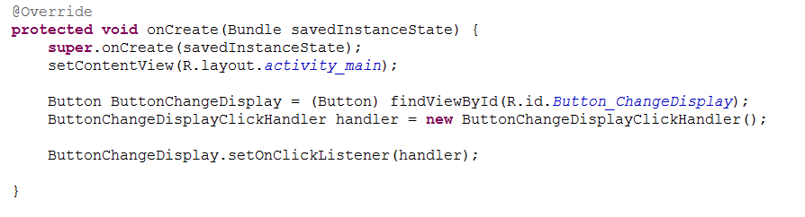
Method 1 – As Inner Class
In the onCreate, create an instance of the inner class, and bind it to the button.
Notes:
In the onCreate OR WHEREVER YOU WANT TO BIND THE CLICK EVENT
Looks like this...
See the steps.
Get a reference to the button
Make an instance of the class
Call setOnClickListener passing in the instance.
Now, if someone clicks on the button, the onClick code of the passed instance is executed.

Slide 11
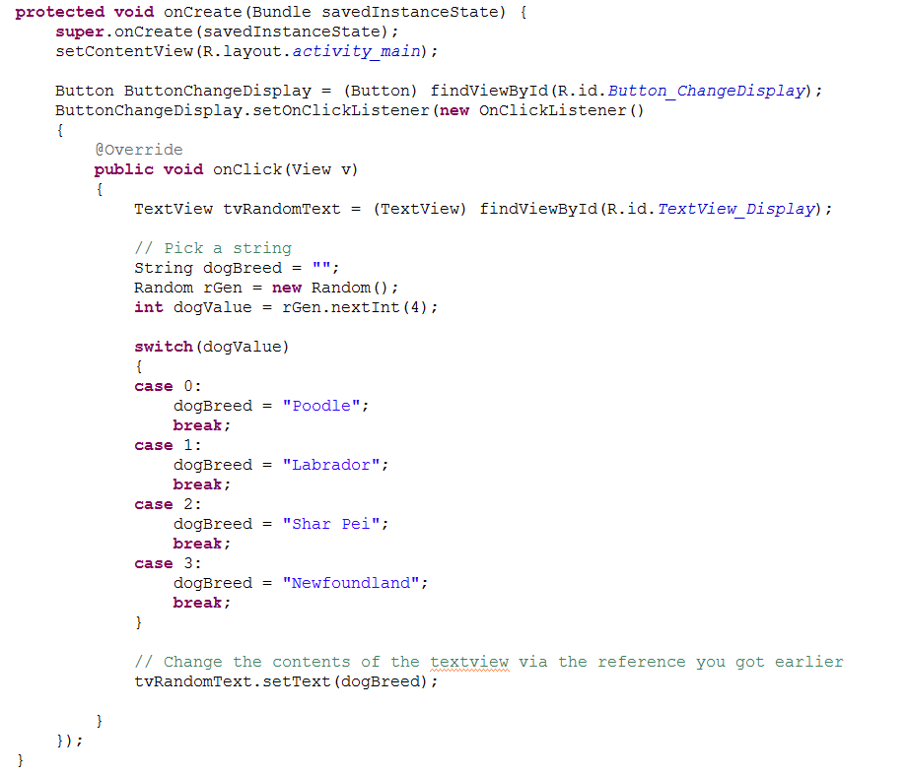
Method 2 - Anonymously
Notes:
Here is a syntactic alternative...
Instead of declaring a class, then making an instance then binding it, you do the whole thing in one statement.
Call setOnClickListener, and where you need to pass in that interface implementer, just declare a new implementer and provide its code.
This is “anonymous” because you never name a class or an instance.
It looks like this.
See that “new OnClickListener()”? That means “Get ready, because I am now going to create an object that implements the interface OnClickListener”.
Note that the code of the onClick method is identical, and the behaviour of the button is identical.

Slide 12
Which Method to Choose?
Which of these do we find more readable?
Which will you find more readable when there are lots of controls and lots of events?
Will you see the other one anyway in the wild?
Why?
There is no agreed "best practice".
Notes:
Which of these do we find more readable? => Class.
Which will you find more readable when there are lots of controls and lots of events? => Class.
Will you see the other one anyway in the wild? +> Yes.
Why? => Programmers are lazy?
There is no agreed "best practice". Worth doing some reading to see different stated pros and cons.

Slide 13
Other Syntactic Options
http://androidcookbook.com/Recipe.seam?recipeId=2359
Notes:
Keeping in mind what you really have to accomplish here – pass in an object to setOnClickListener which defines an onClick event – can you think of any other syntactic approaches?
The goal IS NOT TO PRODUCE SHORT CODE.

Slide 14
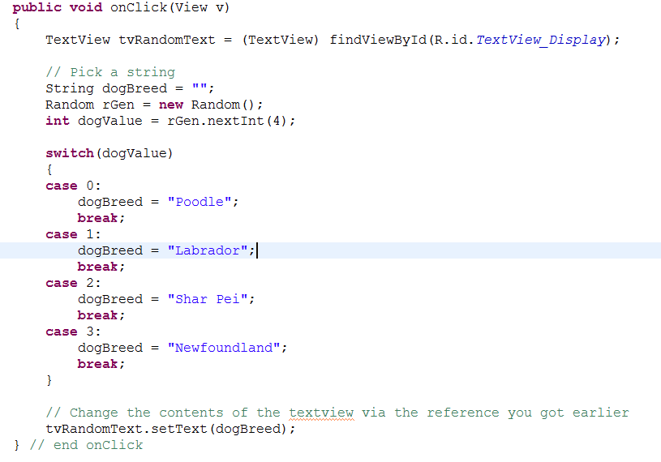
Exercise
Assume you have this class method
Notes:
Let’s consider one syntactic alternative that you may see.
Imagine you have written this code in the class
Outside of onCreate, but in the class, just like any other class method.
Can you bind this method to a button click? => You would expect so, because the method is of the correct prototype.
But how...?

Slide 15
Exercise
Button ButtonChangeDisplay = (Button) findViewById(R.id.Button_ChangeDisplay);
ButtonChangeDisplay.setOnClickListener(???);
ButtonChangeDisplay.setOnClickListener(this);
Add implements OnClickListener to the declaration of the Activity class.
Notes:
You’ve got your button reference.
You can call its setOnClickListener.
But what do you pass in?
Remember that we pass in an object that has an onClick method.
This class has an onClick method
So, we can pass ourself in...
However, this won’t compile.
Because setOnClickListener doesn’t want “someone with an onClick method”, it wants “someone who implement OnClickListener”.
While these work out to logically the same, syntactically they are a little different.
So we must do what? => add the interface
This doesn’t seem like a great approach to me, frankly. I like the whole “declare an inner class” way.
One of the reasons is that this approach works very nicely when you have controls that respond to lots of different events – that is when your event handler interface has multiple methods.
The other approaches get very messy, very fast.
But if you are going to look at other people’s code (and you will), you need to realise that people will take different approaches.
Just keep in mind the eventual goal (get something that implements OnClickListener into that set call) and you should be able to work out what they’ve done, no matter how weird it is.

Slide 16
Toast
Toast (android.widget.Toast) exposes two important methods:
the static method makeText
the instance method show.
Notes:
We are going to do a practical now, but first we want to meet a useful little Android class.
We will first look at Toast, a useful class for displaying small bits of text on the app screen at runtime, then we will work through a number of exercises.
When working with Android in Eclipse, you have access to the runtime debugger. You can also generate log messages to LogCat (covered later). These can both be very useful when hunting for tricky bugs. However, during development we often want to generate simple observable behaviours that give us insight into what our code is doing when it is working correctly. In C#, for example, we make frequent use of MessageBox.Show to pop up useful status messages. In Android, the equivalent construct is Toast.

Slide 17
Toast
makeText is (like) a constructor
Context context | The current activity
CharSequence text | The literal string you wish to display
int duration | The amount of time you wish to show the Toast text for. Although this variable is of type int, you can’t just pass in any value you want. You have to use one of the Toast class constants (static ints) LENGTH_LONG or LENGTH_SHORT.
Notes:
That is, it returns a Toast object
The argument are…

Slide 18

Toast
Notes:
If, for example, we wanted to raise a little message from inside our Activities onCreate method, we could create an appropriate Toast instance like this:
After the Toast is created, you display it to the screen with the show command. For example, if we have created Toast statusToast above, we could raise it with:

Slide 19
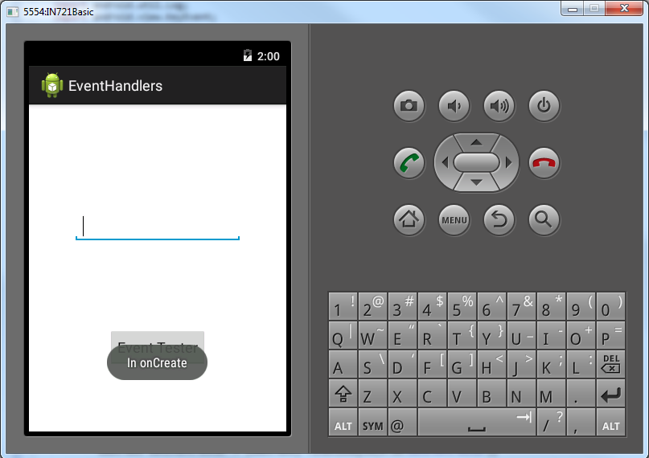
Toast
Notes:
Because this code is contained in the onCreate method, it is executed when the application starts, and it looks like this:
The Toast message pops up for a few seconds, and then fades away.

Slide 20
Toast
Notes:
Note that you will often see these two lines of code compressed into one, as follows:
Since you are chaining the call to show onto the call to makeText, you don’t need to store the Toast as an instance.

Slide 21
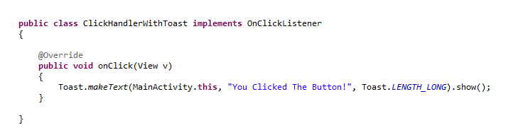
Using Toast in Event Handler Classes
You can’t access the Activity with “this”
Use ActivityClassName.this
Notes:
As stated above, to bind code to events, we must create objects instances (either concretely or anonymously) that support the relevant interfaces.
When we do this, the handler code method (for example, the code in onClick(View v) when working with button click events) belongs to the handler object instance not to the Activity.
This is easiest to see when we have declared an inner class, since the method belongs to that class, not to the outer Activity class, but it is equally true with “on-the-fly” declaration.
This changes the way we must call Toast.makeText. Specifically, we can no longer pass “this” in as a reference to our activity. If we use “this” inside the inner class, it refers to that inner class, not to the containing Activity class. To correctly refer to the containing activity, you must say…
For example, assume that we have an Activity class called MainActivity. We wish to wire up a button click handler, so we want to declare an inner class that implements OnClickListener. To use Toast in that handler we can say:

